Slide 1

Visual pollution detection using deep learning

Slide 2
Team Member
Name | Student ID | Role
Fawaz Ayashi | 2190005071 | Leader
Nawaf Alqurashi | 2190001868 | Member
Abdulhadi Alamoudi | 2190003431 | Member
Turki Almutib | 2200400140 | Member
Saifallah Tareq | 2190009096 | Member

Slide 3
Agenda
Introduction
Review of Literature
Dataset Description
Methodology
Result and Discussion
Conclusion

Slide 4


introduction

Slide 5
introduction
Improve our city
improve the state
Smart city
2030 vision

Slide 6
Review of Literature

Slide 7
Review of literature
Reference | Model used | mAP50
[1] | YOLOv4 | 93%
[2] | YOLOv3 | 25%
[3] | YOLOv4 | 80%
[4] | YOLOv3 | 85%
[5] | YOLOv5 | 88%

Slide 8
Dataset description

Slide 9
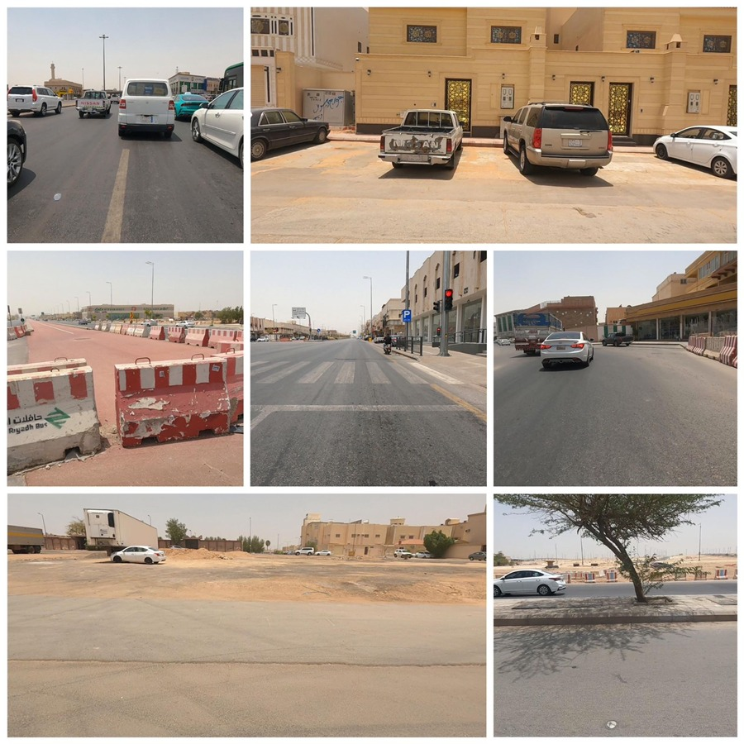
Dataset description
Our Dataset from SDAIA
Contains 10 classes and 12,110 images

Slide 10
Methodology

Slide 11




Methodology
Dataset
Training using model YOLOv5s
Validation & Evaluation
Object detection model

Slide 12
Result and discussion

Slide 13
Result and discussion
CLASS | Image | Instance | Precision | Recall | mAP50 | mAP50-95
ALL | 1211 | 857 | 0.204 | 0.374 | 0.177 | 0.0681
GRAFFITI | 1211 | 51 | 0.19 | 0.588 | 0.203 | 0.0875
FADED_SIGNAGE | 1211 | 5 | 0.222 | 0.4 | 0.107 | 0.0333
POTHOLES | 1211 | 87 | 0.107 | 0.195 | 0.0497 | 0.0139
GARBAGE | 1211 | 371 | 0.153 | 0.388 | 0.108 | 0.0305
CONSTRUCTION_ROAD | 1211 | 107 | 0.16 | 0.383 | 0.178 | 0.0554
BROKEN_SIGNAGE | 1211 | 5 | 0.396 | 0.4 | 0.336 | 0.17
BAD_BILLBOARD | 1211 | 75 | 0.253 | 0.493 | 0.211 | 0.0695
SAND_ON_ROAD | 1211 | 30 | 0.167 | 0.333 | 0.114 | 0.026
CLUTTER_SIDEWALK | 1211 | 122 | 0.223 | 0.311 | 0.179 | 0.06
UNKEPT_FACADE | 1211 | 4 | 0.172 | 0.25 | 0.286 | 0.135

Slide 14
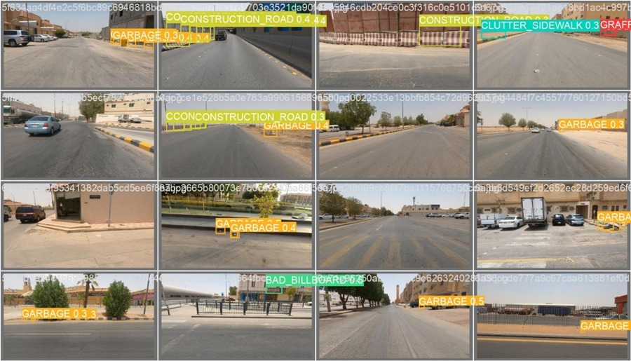
Result and discussion

Slide 15
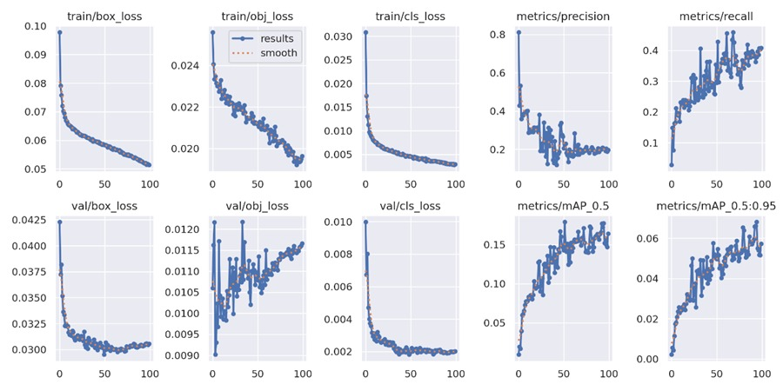
Result and discussion

Slide 16
Conclusion

Slide 17


Conclusion
we evaluated the performance of the YOLOv5s object detection model on a dataset consisting of 12,110 images and 857 instances across 10 classes. The results showed varying levels of performance for different classes.

Slide 18
Any questions?
Thank you!

